Slide 1
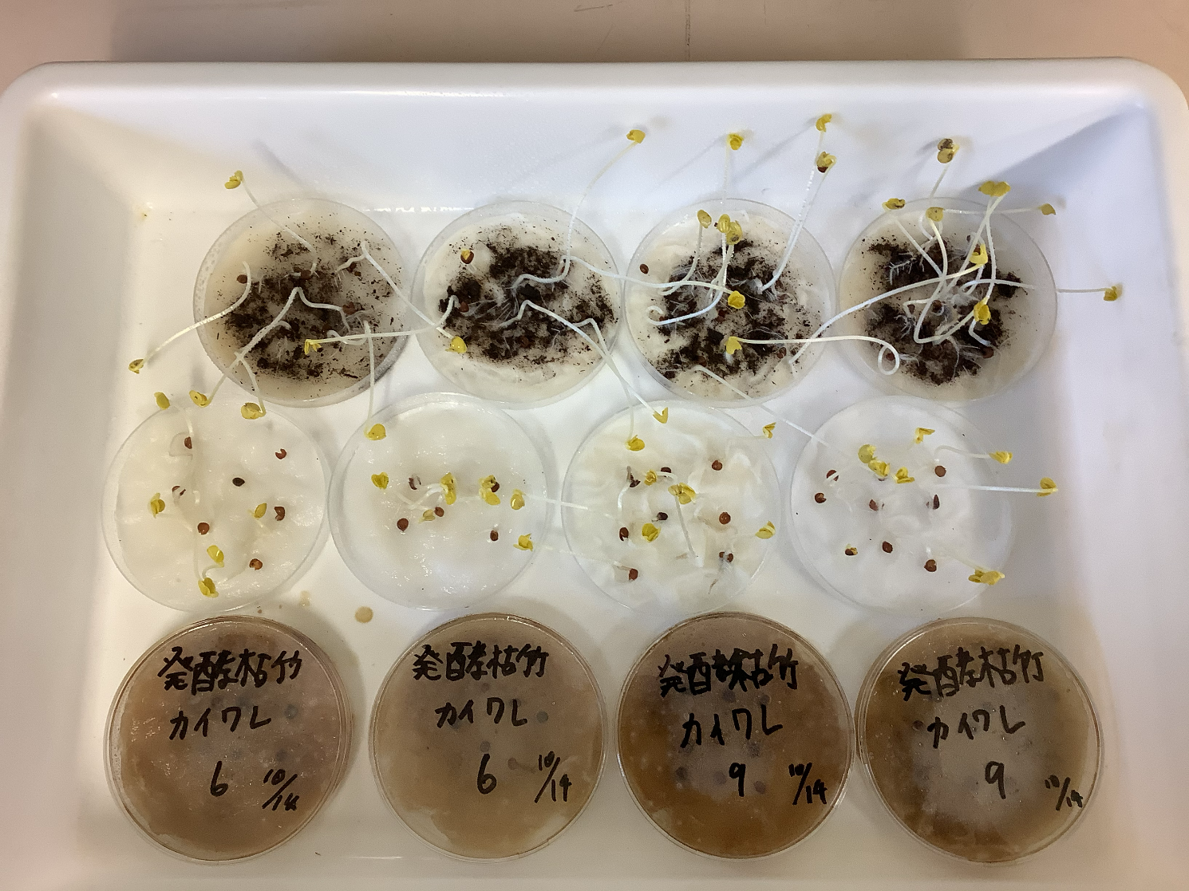
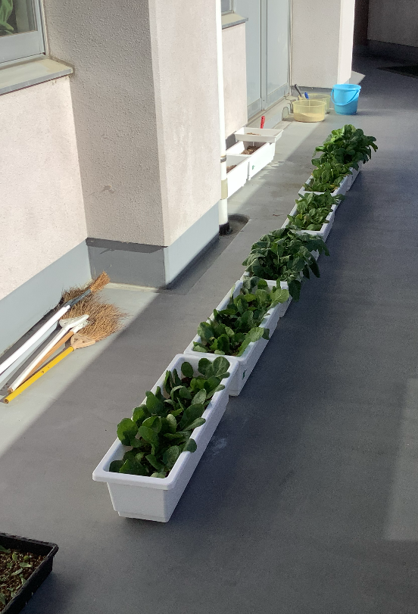
【目的】
発酵させた枯れ竹パウダーで土壌改良剤としての効果を調べる。
【仮説】
発酵させた枯れ竹パウダーでも市販のものと同様の効果が見られるのでは
ないか。また、なし（何も入れないもの）よりも成長するのではないか。
【方法】
プランターを用意しそこにハツカダイコン、コマツナを植え
以下のものを入れ成長の違いを調べる。
A なし（何も加えないもの）
B 市販
C 発酵させた枯れ竹パウダー
【結果1】 有意差検定 葉の長さ
ハツカダイコン
なし ＜ 市販 ＜ 発酵させた枯れ竹パウダー
コマツナ
なし ＜ 市販 ＜ 発酵させた枯れ竹パウダー
【観察】
○掘り起こした際、枯れ竹パウダーを使用したプランターの中から、
枯れ竹パウダーの塊が出てきた。
○葉が大きいほど根も大きかった。
【結果】 【配置】
発酵した枯れ竹パウダーが
最も成長したと考えられる。
→しかし、、、
How to utilize dead
bamboo
Abstract
Increase in abandoned bamboo forests
Cause：Demand for domestic bamboo declined due to inexpensive imports.
Neglected due to decrease in number of cultivators.
What will happen as a result of the increase in abandoned bamboo forests?
→Bamboo roots encroach into the surrounding area
and inhibit the growth of trees growing there.
→Landslide damage will increase.
→The dead bamboo breaks and falls over,
making it even more difficult to manage.
Characteristics of Bamboo
Because all the tissues are aligned axially parallel to each other,
it it very hard to break.
→Some of the abandoned bamboo groves have changed color and
decayed over time. some of them have changed color and decayed.
→Another feature is that it
grows quickly.
Research Objectives
Previous research
Bamboo powder is currently used as a soil conditioner.
Commercial bamboo powder undergoes lactic acid fermentation.
→However, with this method, we cannot be absolutely sure
that fermentation is taking place! Therefore, we decided to conduct
our experiment with alcohoic fermentation, where we can confirm fermentation.
Most bamboo covers Hita.
Isn't it also important to utilize dead bamboo to solve the problem?
<Prediction of the amount of bamboo growing in Hita in the future〉
The area of bamboo forests in Hita , Oita Prefecture is 7,820,000 square meters.The number of newly grown bamboo plants is estimated to be about 106,000 per year.
Hypothesis
Application of Fermented Bamboo Powder in Agriculture
Dead bamboo powder can be used to promote plant growth as well as commercial bamboo powder.
Tamana-no-moto was made in September 2008.A fertilizer (soil conditioner) using nothing but bamboo. The honeycomb structure of bamboo and lactobacilli increase the number of microorganisms causing the soil to be more compact.Roots grow firmly, the yield increases, and the taste improves due to bamboo-derived amino acids.
Difference between soil conditioner and fertilizer:
Soil conditioner→applied to change the properties of the soil
Fertilizers: applied to the soil to nourish crops
Preliminary experiments
【Result 1】
None of the kaiware radish grew long and did not germinate with dead bamboo powder. Both commercial and “none” died without growing completely.
【Observation】(radish and komatsuna)
When dug up, clumps of the dead bamboo powder were found in
the planters where it had been used.
○The larger the leaves, the larger the roots
were.
【Result】
The one that used fermented withered
bamboo powder grew the most.
【Purpose】
To confirm that the withered bamboo powder is undergoing
alcoholic fermentation with dry yeast.
→ Since it is possible to confirm that fermentation is taking
place this method was used.
【Hypothesis】
The Same reaction occurs with the same amount of glucose.
【Methods】Ensure that the withered bamboo powder has
undergone alcoholic fermentation with the dry yeast. Put the
withered bamboo powder or glucose, dry yeast, and water in a
Kühne fermentation tube, warm it, and add a NaOH solution.
Then, check if the gas produced is carbon dioxide.
【Results】
Since both were confirmed to
generatie of gas, fermentation was
observed in both cases.
【Discussion】
○Can fermentation methods be confirmed
by using something other than dry yeast?
【Discussion】
○Kaiware radish grows in water.
The soil conditioner may not have been
effective as a soil conditioner because
kaiware daikon grows in water.
The concentration of dead bamboo
powder was high, So the concentration
of dead bamboo powder might have
been too high.
Wall
Planters
Experiment I
〈radish〉
〈komatsuna〉
【Purpose】
Fermented withered bamboo powder will be used to study its
effectiveness as a soil conditioner.
【Hypothesis】
Fermented withered bamboo powder would have the same
effect as commercial products. It may be possible to see the
same effect with fermented dead bamboo powder as with
commercial products. Also, it may grow better than using
nothing.
(without adding anything).
【Methods】
Kaiware radish, komatsuna, and hatsuka radish, were divided
and each were put these One of these in.
A None (nothing added). B Commercial product
C Fermented withered bamboo powder
【How to make withered bamboo powder】
Mix 125g of dead bamboo powder, 75g of dry yeast and 253g of water. Ferment it at about 40°C for about 2 to 3 days.
Withered bamboo powder
Commercial product
〈Composition 〉
・Akadama soil
・Kanuma clay
・Peat moss and bark
compost
・Kunzan charcoal
None
〈Fertilizer blended or not〉
Yes.
〈pH〉
6.0 to 7.0

Slide 2
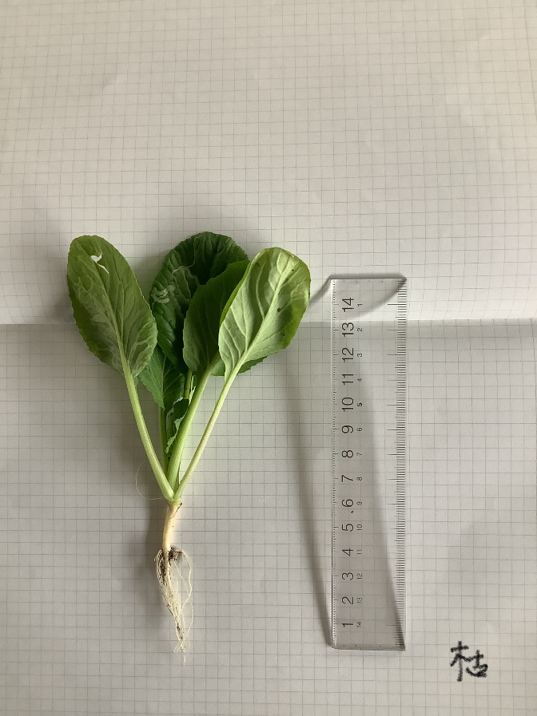
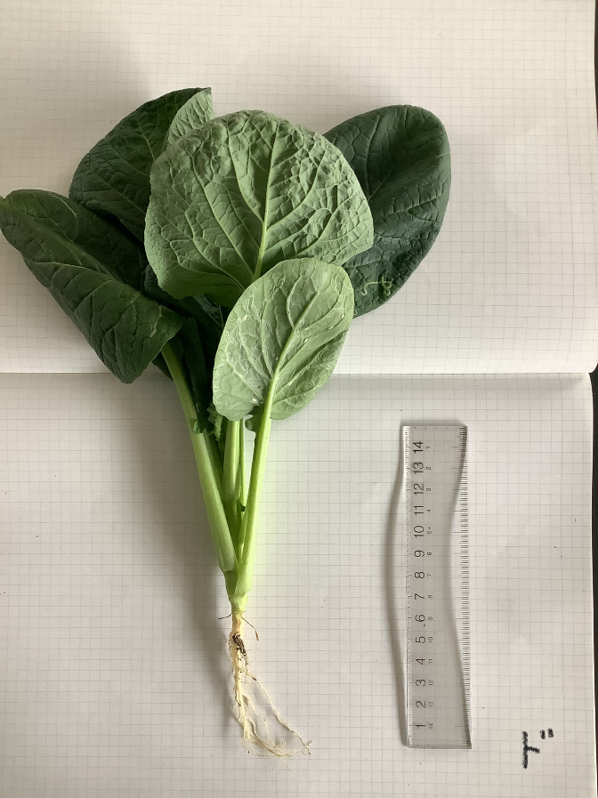
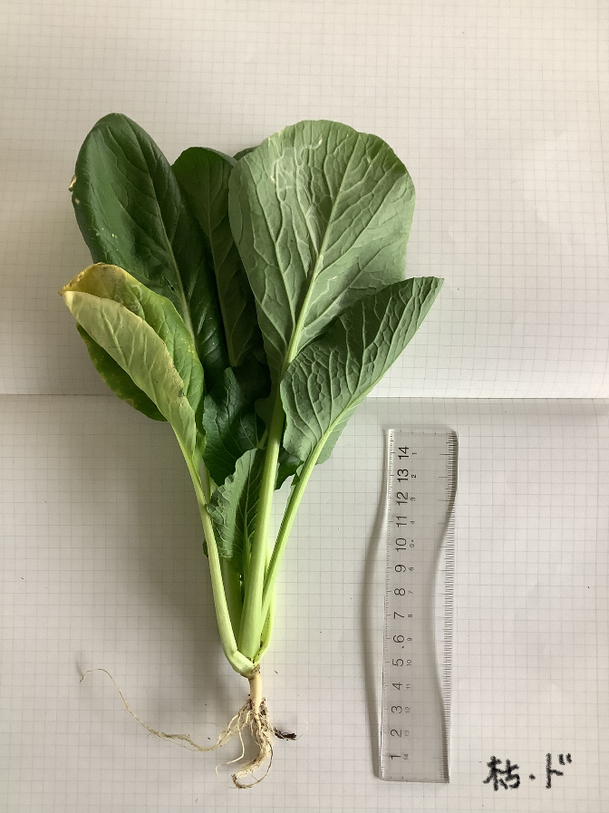
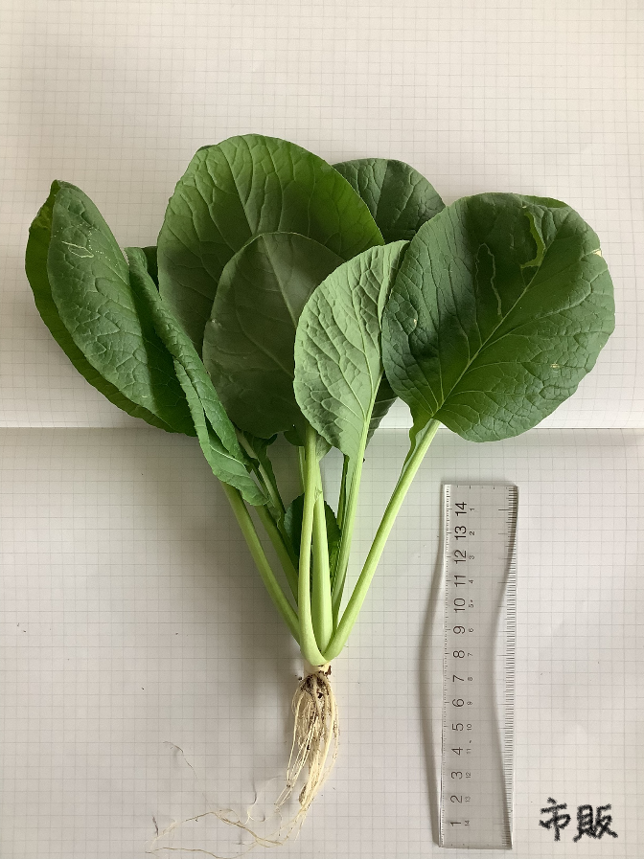
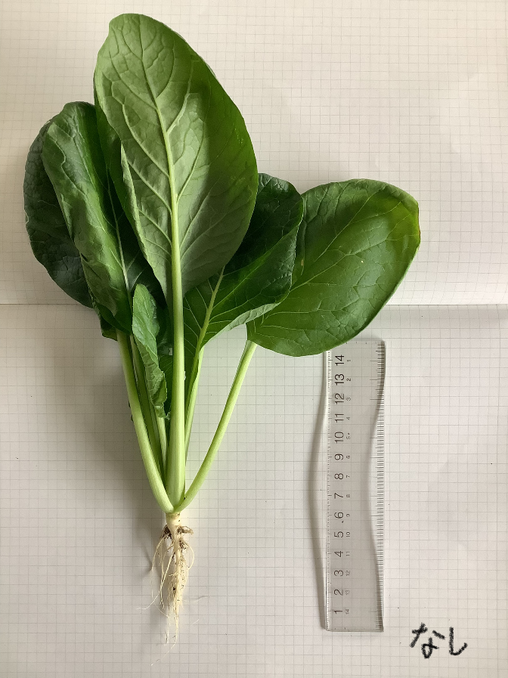
【Results】
Significance test Leaf length
Commercial product,
withered bamboo
【Considerations】
○Fermented dead bamboo powder
was left as clumps in the soil.
→The fermentation of the fermented
dead bamboo powder may be
further fermented and have a
positive effect on the plants.
○There may have been a
difference in environmental
conditions.
○The dry yeast used may have had
an effect.
○Mass and sugar content should
also be observed.
〈radish 〉
None, withered bamboo
None, commercial product
［Significant
differences］
None
Confirmative
Confirmative
〈komatsuna〉
None, withered bamboo
Commercial product,
withered bamboo
None, commercial product
Ingredients of commercial bamboo powder
Total nitrogen (N): 0.2%
Total phosphoric acid (P): 0.08%
Total potassium (K): 0.08%
pH: 6.2
［Significant
differences］
Confirmative
Confirmative
Confirmative
Experiment II
 | Withered bamboo only | Dry yeast only | Dry yeast withered bamboo | Comm-ercial | None
Water content | 6.22 | 37.20 | 20.27 | 19.50 | 19.00
Weight(g) | 7.00 | 40.20 | 22.10 | 21.50 | 21.00
Dry weight(g) | 0.78 | 3.00 | 1.83 | 2.00 | 2.00
【Purpose】
Confirm that the growth in Experiment 1 was not due to dry yeast.
【Hypothesis】
The same effect can be seen with dead bamboo alone as with fermented bamboo.
【Methods】
Experiment with C：only dry yeast and D：only dead bamboo powder for comparison to the comparison subjects in Experiment 1.
【Results】
【Considerations】
The results in Experiment 1 are considered to be largely influenced by dry yeast.
Conclusion
Withered bamboo powder is considered to be capable of alcoholic fermentation.
In addition, at this stage, withered bamboo powder is not considered to be an effective method for use as a soil conditioner.
If unwanted items such as withered bamboo could be utilized as a resource, it would lead to the development of a more sustainable resource.
Future Plans
○Experiment again, focusing on the ratio of dry yeast to dead bamboo powder.
○Examine the fungi that can ferment dead bamboo.
（Lactic acid bacteria, yeast bacteria, natto bacteria）
○ Investigate the definition of fermentation.
○Examine other ways to utilize dead bamboo.
５．結論
References
We would like to thank everyone who cooperated in our research.
Acknowledgements
Maintenance of abandoned bamboo grove and utilization of bamboo-NPO法人竹取物語
Utilization of fermented bamboo poder for agriculture-産業連携ネットワーク交流会
sixth industrialization of bamboo grove regeneration-合同会社たまな
Estimated amount of ethanol that can be obtained by a single bamboo-静岡県立科学技術高等学校
Mousouchiku covers Hita-Oita prefectural Hita High School
Chemistry I – 大阪教育大学-section number 69 experiment I “alcohol”
Matsumoto inc. -https://takenokona.com/products
GARDEN STORY- https://gardenstory.jp/gardening/46357

