Slide 1
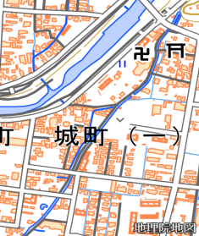
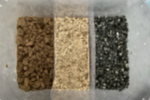
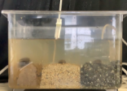
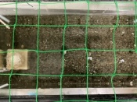
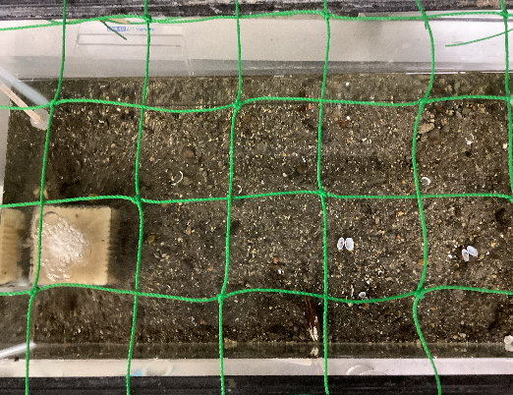
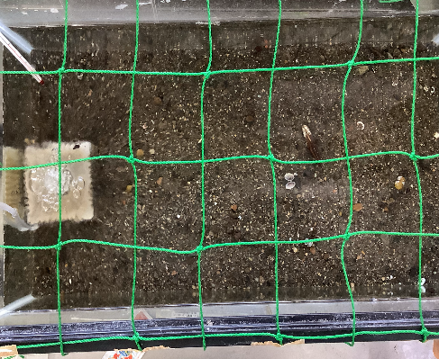
Where is the Best Environment for Freshwater Bivalves？
Research Background
Since ancient times, Hita has been rich in clean water. However, in recent years, the water quality and ecosystem have been deteriorating. In order to maintain the Hita’s clean water we focused on the bivalves, which are used to spawn tanagos in the ecosystem, and conducted research for the purpose of protecting them.
Tongari-sasanohagai
Lanceolaria grayana
Matsukasagai
Pronodularia japanensis
Previous research last year
Fieldwork in Jonai River
Due to river construction, the number of bivalves living in the Jonai River had decreased.
Upper course
A
Purpose: Observing the area of ​​Hita City where bivalves are located and the environment where they are located
・ River construction
・ Water quality
Ms Hasimoto speaking
・A lot of bivalves died because the water dried up during the river construction.
The size and texture of the sand at all site are different.
・Since the amount of water has not turned sufficiently, the bivalve population does not recover.
B
Water volume
C
Lower course
The sand
Experiment 1 Dive depth
※Dead bivalves were found at sites B and C in the Jonai River
Experiment 3 Observation of movement
Purpose ：Learn about how easily bivalves can dive in each of the three types of soil (gravel,sand and mud)
Purpose: Investigate the normal movement of bivalves and compare with Experiment 2.
Method：
Using gravel sand and mud, we investigated the diving depth of Matsukasagai and Sasanohagai bivalves over 8 hour from 8:00 to 16:00 .
Method
Using the sand at point C where many bivalves were found, investigate how the bivalves move for 4 days with two shells.
Before the experiment
During the experiment
Before the experiment
・Bivalves can dive in any soil type.
consideration ・There is a difference in the timing of diving of bivalves
result
Experiment 2 Bivalve sand preference
Purpose: To know if bivalves have a soil prince .
Method: Put two types of sand from Experiment 1 in a water tank, place bivalves on the boundary of the soil type , and observe how they move.
Matsukasagai
sasanohagai
・Even in the sand where the bivalve was, the bivalve moved to the one with the legs
・The distance traveled was about 10.8 cm
Experiment by changing the direction of the foot
summary
Experiment 1 →Bivalves dive in any sand
Experiment 2 → Bivalves do not choose the sand to dive by themselves
Consideration:
Bivalves dive due to and do not choose sand by themselves
Experiment 3 → Bivalves cannot move large enough to change their habitat
砂質の種類によらず、足のある方向から潜砂する
足のある方向から移動の違いは
見られなかった
砂を選んで移動しない

Slide 2
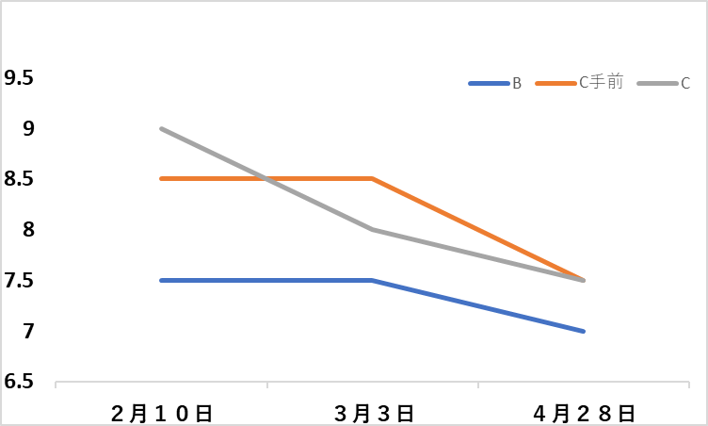
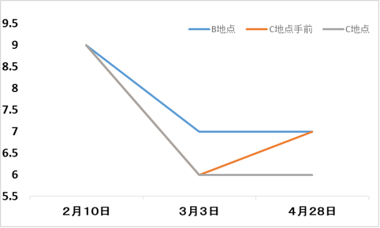
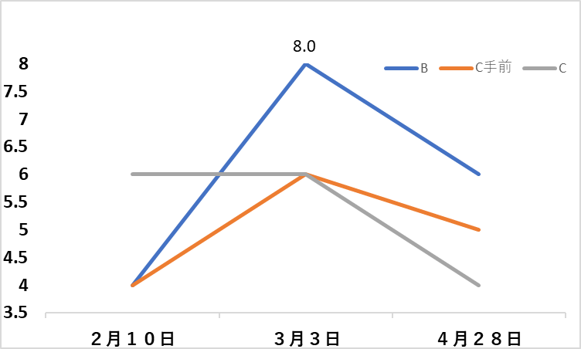
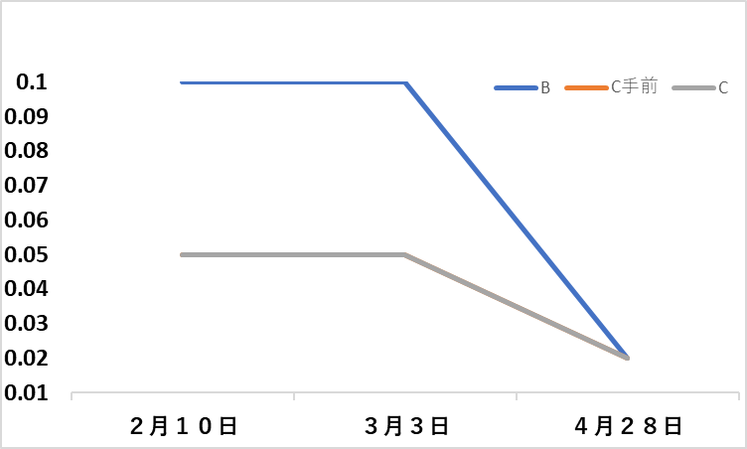
Water quality survey
Purpose：Compare the water quality where bivalves live in and where they don’t
pH
DO
COD
HNO2
・The Water quality is deteriorating due to artificial factors such as river cleaning and river construction
・ The Water quality is improved by the flow of water.
Population survey
River construction（From mid-Jan. to the end of Mar.）
Two months comparison
Year comparison
From the survey results of the Hita Freshwater Fish Club
 | 3/3 | 4/28
C Tributary | 3 | 0
C Main Branch | 7 | 2
 | 2017 | 2018
C Main branch | 38 | 6
2019 | 2020 | 2021
3 | 16 | 7
Heavy rain in Northern Kyushu
Heavy rain in July 2020
Decreased after river construction
Decreased after heavy rain
Summary
Types of sand：Bivalves can bury into all types of sand.
Water quality：Bivalves can survive in the Jonai River’s environment.
Water amount：Bivalves cannot breed and survive in environment which don’t have a certain amount of water.
Others influence ：River construction decreases the number of bivalves.
→The place where there is not river construction is suitable for bivalves.
In conclusion, the downstream of Jonai River is suitable as an area to protect bivalves.
One of our ideas
除去後の砂
Sand after removal
Acknowledgment
Jonai
Chika Hashimoto of Hita city Museum,
Hita Freshwater Fish Club,
everyone at the Environment Division of Hita City Hall.
保護地区
C
area protecting bivalves
Downstream
References
C
・Izumi Sakurai,Masafumi Seto,Shigeru Nakao
Effects of Water Temperature, Salinity and Substrata on Burrowing Behaviors of the Three Bivalves, Pseudocardium sachalinensis, Mactra chinensis, and Ruditapes philippinarum.
・Tomoki Kikuti,Kazuya Watanabe
Environment alstructure condition so firing action canal son Union Ovid mussels
・Syoutaro Yoshimi 、Mikio Inoue、Hiroki Hata
Experimental introduction of the endangered freshwater unionid Pronodularia japanensis to spring-fed ponds in Matsuyama
城内川の水
Jonai River’s water
Prospects for the future
・We want to research a certain value about water quality and amount.
・We want to seek the most place suitable as an area protecting bivalves.
・We want to research bivalve conditions breeding.

