Slide 1
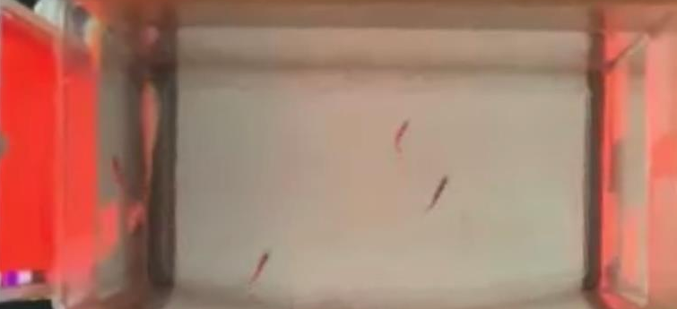
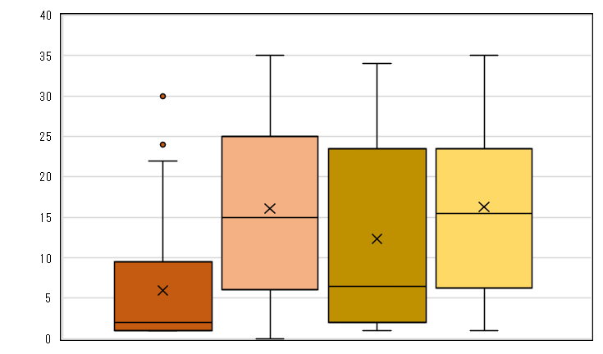
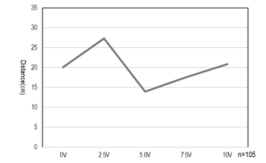
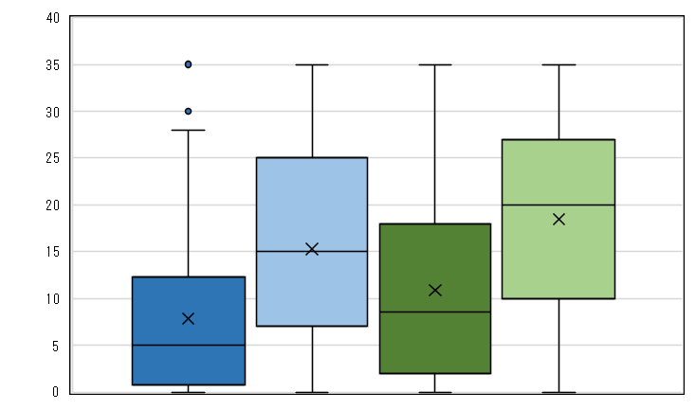
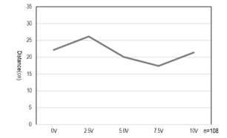
Pleasant and unpleasant memories in zebrafish
Oitamaizuru High School Team Zebrafish Ikeda Taiyo Kuwabara Saki Shibuya Kotoha Mae Tomoki
Motivation
The zebrafish that we breed at our school gather when we get close to the water tank.
We suspect that it can understand the human's action to give them food and judge whether human do so or not.
Purposse・Hypothesis
We studied zebrafish's ability to memorize comfortable and uncomfortable.
Hypothesis1:Zebrafish approach the light source when they recognize red light.
Zebrafish go away from the light source when it recognize blue light .(Research 1)
Hypothesis2:The stronger voitage is, the farther zebrafish go away from light source.(Research 2)
Result
Zebrafish were able to recognize red and blue. They were also able to memorize the behaviors associated with them. However, they judged the marbles to be objects of interest. We found that there were individual differences in the behaviors remembered
by zebrafish.
Goals
We want to conduct the same research by multiple individuals and one individual and comfirm the difference betweet group and solitary behavior in zebrafish.
🐡Consequence
Behavioral change during the 10 seconds that color is presented
・Compare the first day's record and the last day's rcord in water tank 1 and 2, We couldn't see any changes.
※Horizontal axis of graph show "the time(sec)", vertical axis of graph show "the distance from iPad(cm) ."
Preceding Study
Research 2
■Rakuhoku High School (2018)
They revealed Zebrafish can learn each color that means being fed or being shocked by electricity.
■HIroshima University High School
They revealed Zebrafish get away by flipping their body when the object approached.
■Oita Maizuru High School (2020)
They sutudied Zebrafish by using Fear Conditioning. They concluded that Zebrafish recognizes still images and has the ability to memorize them .
🐡Consequence
Distribution of the position of the mean at the switch between
red and black light
🐡Purpose
To reveal zebrafish's ability to memorize uncomfortable
🐡Materials ＆Method
・Target 5 adult zebrafish
・time 7:30 and 17:00（for about 20 minutes） confirmation is at 12:30
・Method
We prepare five equal sized tanks, one adult zebrafish was placed in each tank.
For each tank, current was applied at five defined voltages (0v, 2.5v, 5.0v, 7.5v, and 10v).
●Survey flow
➀ Place 2 electrode plates in the tank (5 cm from the edge) and wait 1 minute
➁ Blue light stimulation with an iPad and current for 10 seconds during which the light is presented.
During ➀➁, the zebrafish's movements are filmed from above with an iPad.(Fig. 5)
・There was a significant difference in the position of the mean at 0 and 10 seconds, with tank 1 closer to the light source than tank 2.
・There was a significant difference in the position of the averages at 10 seconds, with tank 1 being closer to the light source than tank 2.(Fig. 3)
About a Zebrafish
■tank1 0s ■tank2 0s ■tank1 10s ■tank2 10s
Relationship between days and position at 0 second
Distance (cm)
**
**
Relationship between days and position at 10 seconds
Zebrafish[scientific name; Danio rerio](Fig.1)are fresh water fish native to India whose length of body is about 5cm and it has the body color of blue stripe pattern.
It is widely used as model animal in biological researches. It is easy to breed and the base of brain is simplicity and like human's one.
Black
(5sec)
Blue
Electric shock
(10sec)
Black
(5sec)
Fig. 5
Fig. 1 zebrafish
Fig. 3
**:p<0.01 n=280
🐡Consequence
In the color switching, comparing by average position throughout the survey, compared to 0V, 2.5V was farther from the light source. The 5.0V and 7.5V were closer to the light source. However, no difference in distance from the light source was observed between 0V and 10V.(Fig. 6,7)
🐡目的
ゼブラフィッシュの「快」と「不快」に対する記憶能力を明らかにするため
🐡方法
・対象 ゼブラフィッシュ成体10個体
・時間 7時30分，17時から約20分間，確認は12時30分
・方法
赤色の光を提示したときに餌を与え、青色の光を提示し たときにビー玉を水槽の側面に沿うように落とした(図2)
🐡調査の流れ
・場所 生物職員室
・項目 色を掲示した10秒間、
黒から赤(青)、赤(青)から黒の
切り替わり5秒間
（赤・青➔黒に切り替わる時に投入）
Research 1
🐡Discussion
・The zebrafish were gathering in response to red light both during the black to red and red to black transitions, as indicating that the zebrafish remembered the black and red transitions and approached the iPad.
・The zebrafish remembered that the red light was a signal for feeding because they approached the red light.
🐡Purpose
To reveal zebrafish's ability to memorize comfortable and uncomfortable
🐡Materials & Method
・Target 10 adult zebrafish
・Time 7:30 and 17:00（for20 minutes）
confirmation is at 12:30
・Place Biology staff room
・Research item
➀10 seconds of color presented,
Black to Red(Blue), Red(Blue) to Black
➁5 seconds to switch
（Drop them in when switching colors）
・Method
①Feed them when we show the red light
②Drop the marbles when we show the blue light
(Fig. 2)
🐡Survey flow
🐡Consequence
Distribution of the position of the mean at the switch between blue and black light
・There was a significant difference in the position of the mean at 0 seconds, with tank 1 closer to the light source than tank 2.(Fig. 4)
■tank1 0s ■tank2 0s ■tank1 10s ■tank2 10s
Distance (cm)
**
Fig. 6 Mean distance across survey at 0 second
Black
(5sec)
Red
or Blue
(10sec)
Black
(5sec)
🐡Discussion
When we compare the data of the first day and one in the last day, none of them changed. We thought that zebrafish can memorize the switch of the light.
Recording iPad
Fig. 4
**:p<0.01 n=240
Fig. 2 Tank
🐡Discussion
・Zebrafish are approaching the iPad, remembering blue, as they gathered more at the black to blue switch than blue to black.
・The zebrafish's proximity to the blue light indicates that the marbles are an object of interest, not an object of fear.
Fig. 7 Mean distance across survey at 10 seconds
●Water tank 1 Tanks in zebrafish that have actually been conditioned and memorized.
●Water tank 2 Tanks in zebrafish that don't have been conditioned and memorised as
control experiment.
※ We also carry out the light stimulation in tank 2 in order to arrange the conditions.
🐡Discussion
We can't find tendency in distance from
the light resources at the switch of colors. So we thought that there are individual differences in memories of pleasure and displeasure.

